Slide 1








Sentiment Analysis of Yelp Reviews with NLP
Reid Dial, Tony Reyes, Jose Marin, Milo Dufresne-MacDonald
Notes:
REID

Slide 2


TABLE OF CONTENTS
01.
02.
03.
Recap of NLP
Preprocessing & Feature Extraction
Models & Metrics
Notes:
REID

Slide 3

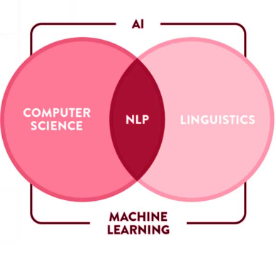
Recap
“Area of computer science that focuses on developing techniques to produce machine-driven analysis of text”
Used for:
Sentiment Analysis
Machine Translations
Chatbots
etc.
Notes:
MILO

Slide 4

MANDATORY PAGE
YELP Reviews
Notes:
MILO

Slide 5
Data Overview
10,000 Reviews with a 5 star rating system
Class Distribution:
Positive: 6,863 (69%)
Negative: 1,676 (17%)
Neutral: 1,461 (14%)
2005 - 2011
Notes:
MILO

Slide 6

Preprocessing Data
Tokenization
Stopword Removal
Example: "hello", "world"
Example: “the”, “is”, “in”
Stemming
Lemmatization
Example: “running” → “run”
Example: “was” → “be”
Notes:
JOSE

Slide 7
Feature Extraction
Bag of Words
CountVectorizer - Converting text into numerical data by counting word frequencies. Ignores grammar and word order.
TF-IDF
Term Frequency-Inverse Document Frequency weights words by their frequency in a document versus their rarity across a corpora. Reduces the impact of common words and boosts rate for rate, meaningful ones.
Notes:
MILO

Slide 8
MANDATORY PAGE
Models
Notes:
TONY

Slide 9
Which one is best?
Model | Accuracy
LinearSVC with TF-IDF | 78.46%
Logistic Regression with TF-IDF | 77.66%
MultinomialNB with CountVectorizer | 76.58%
MultinomialNB with TF-IDF | 69.40%
Notes:
TONY

Slide 10
LinearSVC
Cross Validation
5-fold StratifiedKFold on the training set
Guards against overfitting and data splits bias
Optimal Parameters (GridSearchCV):
Max features: 10,000
N-gram range: (1, 2)
Regularization parameter C: 1.0
Unigrams: "Bad", "Good"
Bigrams: "Really Good"
Notes:
TONY

Slide 11

Metrics
Classification Report:
 | precision | recall | f1-score
negative | 0.72 | 0.64 | 0.68
neutral | 0.41 | 0.22 | 0.29
positive | 0.83 | 0.93 | 0.87
Strong performance on positive and negative reviews
Low performance on neutral reviews

Slide 12
MANDATORY PAGE
How does our model work?
Notes:
JOSE

Slide 13
Feature Importance
Positive
Negative
great
love
awesome
excellent
fantastic
perfect
…
bland
rude
horrible
disappointed
poor
terrible
…
Notes:
JOSE
This slide shows the most important words the model uses to decide if a review is positive or negative.
On the left, we see words that are strongly linked to positive reviews, like great, love, and awesome.
On the right, we see words often found in negative reviews, like bland, rude, and horrible.
These keywords help the model figure out the overall sentiment of a review. So when it sees words like "GREAT" or "BLAND," it uses that as a clue to make a decision.

Slide 14

Examples
"I absolutely love this restaurant!" → Positive (Confidence: 2.39)
"This place is terrible." → Negative (Confidence: 1.37)
"The quality is poor..." → Negative (Confidence: 0.86)
Probability-based models: Confidence ∈ [0, 1].
Decision-function models: Confidence ∈ [0, ∞). It’s unbounded above, since the distance from the decision hyperplane can grow arbitrarily large.
Notes:
TONY

Slide 15
Key Takeaways
LinearSVC outperforms other models for this task
The model achieves nearly 78% overall accuracy
Strong performance on positive and negative reviews (high F1-scores)
Challenges with neutral reviews (22% recall)
Notes:
REID

Slide 16
THANK YOU!
Notes:
REID

